Slide 1
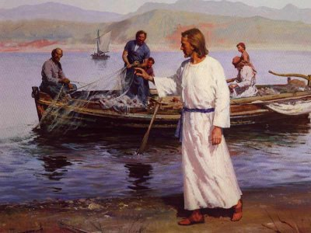
Cast Your Net
“Calling of the Fishermen” by Harry Anderson
Day 2 Intellectual Property and the Common Good: Fostering a Culture of Respect and Sharing

Slide 2
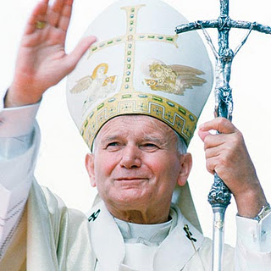
“Do not be afraid of new technologies”
Do not be afraid of new technologies! These rank among the marvelous thing — inter mirifica — which God has placed at our disposal to discover, to use and to make known the truth, also the truth about our dignity and about our destiny as his children, heirs of his eternal Kingdom.”
Pope John Paul II, 2005

Slide 3
Ontario Catholic Graduate Expectations
As members of a Catholic school community, we are called to be self-directed, responsible, lifelong learners. This means we can apply effective communication, decision-making, problem-solving, time and resource management skills.

Slide 4
Questions for Digital Citizenship
Does your use of social media contribute to the common good?
Does your use of social media enhance the lives of others?
What will your “digital footprint” say about who you are?

Slide 5
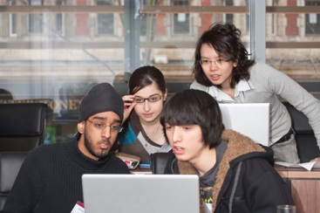
Student instructions
Read the case study that you have been provided
Explore the scenario and issues
Work together to answer the discussion questions
Be prepared to share about your case study with the class

Slide 6
Case Study #1
Intellectual Property and Creative Commons

Slide 7
Case Study #1 The Scenario
The principal of a local school created a “Student Share Portal” on the school’s website. The Student Share Portal is a place for students to post their digital work to showcase it for the school and parent community. The Student Share Portal quickly became very popular with students and parents alike.
Within a week of the official launch of the Student Share Portal, the principal received a phone call from a music production company. The representative complained that one of their recording artist’s music videos had been downloaded and used, without permission, in a student’s multimedia presentation on the school’s Student Share Portal. The music company representative said that this was a copyright violation. After further investigation, the principal learned that many students had used popular music, videos, and pictures from the internet. Much of this material is under copyright and cannot be re-used without permission from the company.

Slide 8
discussion Questions… through a Catholic Lens
Consider the following Catholic Social Justice Teachings when answering these questions: Dignity of the person, Community and the Common Good, Rights and Responsibilities
1. What is intellectual property?
2. What does it mean when something is protected by copyright?
3. Why do people copyright materials like songs, videos, books, photos, etc.? 4. How can the students involved avoid unintentional intellectual theft and breaking copyright law? 5. How can students help the school community move forward in respecting the intellectual property of others?

Slide 9
Case Study #2
Protecting and Respecting Personal Digital Information

Slide 10
Case study #2: The scenario
Karen, a normally shy student at a local Catholic school, was shocked over having learned recently that her school computer account was suspended and that she was facing a possible three day suspension from school.
Her teacher informed her that her account was temporarily suspended because several MP3 song files were downloaded through a pirate-download site during class time and found in her computer account file space. Some of the downloaded files also contained computer viruses.

Slide 11
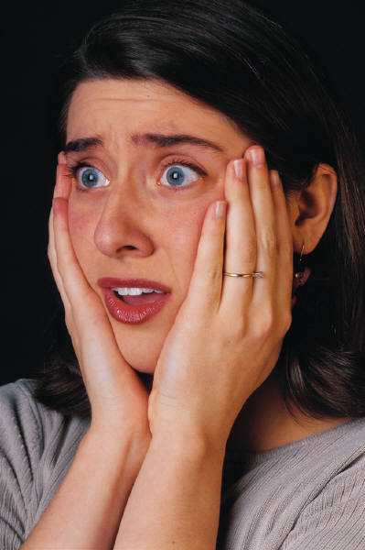
Case study #2: The scenario continued
Karen's shock and disbelief soon turned to anger! She knew that she had never visited the specific sites and downloaded the kinds of song files that the school's computer technician claimed were found in her computer account space.
Karen later remembered that during the period that the downloading took place, she was called out of the class for at least half an hour to attend an appointment with the Guidance Counsellor. She could not remember if she had logged off the computer when she left the class for her appointment. Someone in the class had used her computer, which she had failed to log off of, to download the songs.

Slide 12
discussion Questions… through a Catholic Lens
Consider the following Catholic Social Justice Teachings when answering these questions: Dignity of the person, Community and the Common Good, Rights and Responsibilities
1. Who do you believe is at fault in this situation? 2. How could Karen respond in this situation so as to benefit the school community? 3. While the person who actually downloaded material from the website in question could not be caught, if they were, what should the consequence be for them.
4. How is this situation similar to sharing your password with other people?

Slide 13
Case Study #3
What does your Facebook page say about you?

Slide 14
Case study #3: The scenario
Seventeen year old high school student Michelle is a big fan of Facebook. She posts to her wall almost continuously through the week, but she is a particularly active Facebook fan on weekends as she shares the highlights of her social life. She often posts pictures of her and her friends at parties, dances, and other social events. Additionally, she does not self-censor and frequently uses swear words to describe how she feels. Like many teens her age, she does not think about the long term effects of posting her social life online nor does she worry about privacy settings on Facebook and other social media tools. As a seventeen year old nearing the end of her time in high school, Michelle will soon begin to apply to universities, colleges, and for scholarships, not to mention for a job while at a post-secondary school. Many universities, colleges, and scholarship-granting agencies now routinely check future-students’ Facebook pages to learn more about the person. Employers have also turned to screening applicants for jobs using social media tools like Facebook.

Slide 15
discussion Questions… through a Catholic Lens
Consider the following Catholic Social Justice Teachings when answering these questions: Dignity of the person, Community and the Common Good, Rights and Responsibilities
1. What advice would you give to Michelle for posting on her Facebook page. 2. How could Michelle protect herself online while still sharing with her community of friends? 3. What responsibility does Michelle have to herself, her community, and her parents in this situation? 4. What are Michelle’s rights in this situation? 5. How would you advise Michelle on how to protect her digital footprint that she is leaving online?

Slide 16
Resource List
CBC Documentary Facebook Follies Trailer/Preview on Youtube.com (http://youtu.be/5_qjkSS1-3M)
“10 New Privacy Settings Every Facebook User Should Know” From http://www.allfacebook.com/facebook-privacy-new-2009-12
Creative Commons
A non-profit corporation that makes it easier for people to share
and build upon the work of others, consistent with the rules of copyright.
Creative Commons: What Every Educator Needs to Know - by Rodd Lucier
Flickr-Creative Commons
Many Flickr users have chosen to offer their work under a Creative Commons license,and you can browse or search through content under each type of license.
Copyright Matters: Some Key Questions and Answers for Teachers
Digital Citizenship and Creative Content Program
The Digital Citizenship and Creative Content program is a free, turnkey instructional program.
The goal is to create an awareness of the rights connected with creative content.
Classroom Provisions of the Canadian Copyright Act

