Slide 1
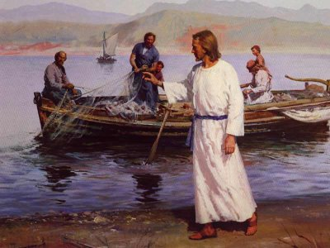
Cast Your Net
“Calling of the Fishermen” by Harry Anderson
Day 3
Our Global Village: Bridging Our Digital Divide

Slide 2
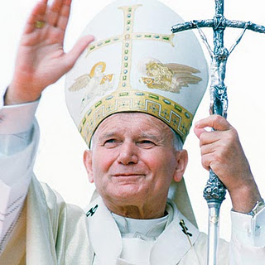
“Do not be afraid of new technologies”
Do not be afraid of new technologies! These rank among the marvelous thing — inter mirifica — which God has placed at our disposal to discover, to use and to make known the truth, also the truth about our dignity and about our destiny as his children, heirs of his eternal Kingdom.”
Pope John Paul II, 2005

Slide 3
Ontario Catholic Graduate Expectations
As members of a Catholic school community, we are called to be responsible citizens . This means we witness Catholic social teachings by promoting equality, democracy, and solidarity for a just, peaceful and compassionate society.

Slide 4
Questions for Digital Citizenship
Does your use of social media contribute to the common good?
Does your use of social media enhance the lives of others?
What will your “digital footprint” show about who you are?

Slide 5
Student instructions
TASK: with a small group, create a proposal outlining how social media tools could be used to accomplish one of the goals below. Be prepared to share with your class.
spread our gospel message
promote a social justice cause
raise awareness about a local or global issue
engage youth in political action
promote our school system and the Ontario Catholic Graduate Expectations
Help others in need in your community

Slide 6
Inspiration from the church
“Go into the whole world and proclaim the gospel to every creature” (Mk 16:15).
“Use of the new information technology and the Internet needs to be informed and guided by a resolute commitment to the practice of solidarity in the service of the common good, within and among nations.
This technology can be a means for solving human problems, promoting the integral development of persons, creating a world governed by justice and peace and love.”
Ethics in the Internet
Pontifical Council for Social Communications
February 22, 2002

Slide 7
Visit several Catholic organizations and see how they are using social media to spread their message and connect with people.
Diosese of London http://wp.dol.ca/webportal/diocese/home/1 Pope Benedict on Twitter https://twitter.com/#!/popebenedictxiv Development and Peace
http://www.devp.org/en

Slide 8
example

Slide 9
Visit the 29 leaps website
http://29leaps.com/
See how this local teen used social media to promote her message and get others involved.

Slide 10
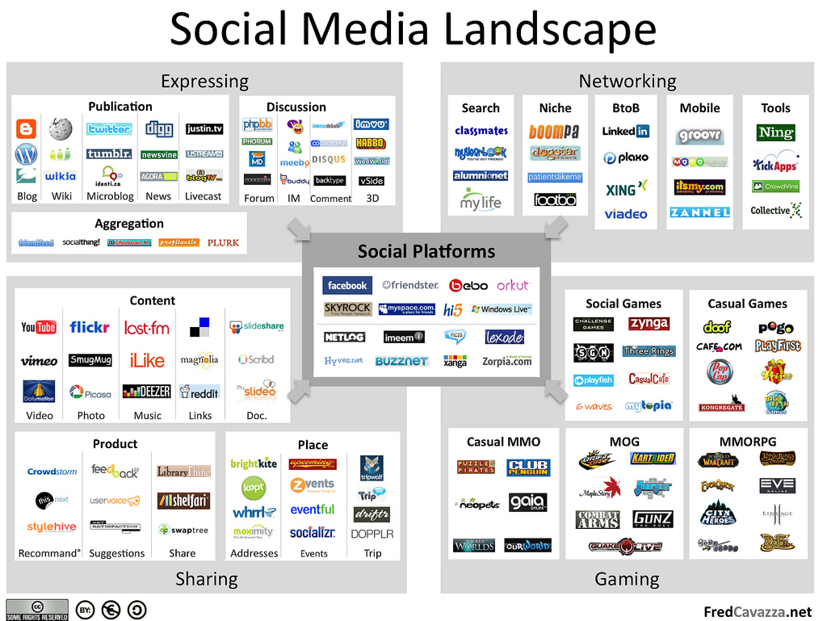

Slide 11
Group Sharing: As each group presents, come up with questions you have about their plan. Extension Questions: How would you evaluate the effectiveness of the use of the social media tools you have selected? How do you know if your message is being heard?

Slide 12
Resource List
Local teen using social media for cause:
http://29leaps.com/
Diosese of London http://wp.dol.ca/webportal/diocese/home/1 Pope Benedict on Twitter https://twitter.com/#!/popebenedictxiv
Development and Peace
http://www.devp.org/en

Slide 13
Further resources
Resources
Cast Your Net lessons and modules are based on the Catholic Curriculum Corporation’s two documents below:
Ethical and Responsible Use Of Information and Communication Technology: A Guideline for all Stakeholders in Catholic Education. November, 2009.
Ethical and Responsible Use of Information and Communication Technology Part II: K-6
The Social Media Landscape
Social Media for Social Good: A Tech Checklist for Non-profit Groups
Other Sites on Safety online
Rules ‘N Tools Checklist: for Parents, Educators, and Other Caring Adults. Implement both safety rules and software tools to protect children online. Focus on the positives of Internet use while teaching children about the dangers and how to make wise choices online.
Internet Safety 101 is a very detailed resource dedicated to making the internet safer for children. There are videos, quizzes, and resources for parents, teachers, & students.

